Slide 1

Principles of Program Design: Problem Solving with JavaScript
Chapter 6
The Repetition Structure

Slide 2
Objectives
In this chapter, you learn to:
Define the repetition structure and discuss advantages of looping
Explain the three control elements of a loop
Describe how a While loop works
Define counters and how they’re used in counter-controlled loops
Define incrementing and decrementing and how they’re used in loops

Slide 3
Objectives (cont’d.)
Define sentinel values and explain their use in loops
Explain the difference between pretest and posttest loops
Describe the Do While loop and its difference from the While loop
Describe the For loop, its advantages over the While loop, and when it’s used
Explain nested loops and give examples
Define accumulators and show their use in loops

Slide 4
Introduction
Repetition structure
  Usually called a loop
  Must allow computer a way to exit the loop
    Code inside the loop does this
  Infinite loop results from failure to provide an “out”
    Must terminate the task at the operating system level

Slide 5
Controlling Loops: Initialization, Condition Evaluation, and Alteration
Without repetition structure
  Would have to repeat code over and over
Repetition structure (loop)
  Set of programming instructions that may repeat:
    As a result of a condition
Advantages of using loops
  One instruction set processes multiple data sets
  Can include selection structures if needed
  Can operate on known or unknown quantities

Slide 6
Controlling Loops (cont’d.)
Iteration
  Each execution of statements in a loop
Condition for performing the statements must be clear
  Use a loop variable
Three loop components
  Initialization of the loop variable
  Condition evaluation: determines loop iteration
  Alteration
    Changing the loop variable

Slide 7
Controlling Loops (cont’d.)
Infinite loop
  Loop never stops because condition is always true
Counter
  Specifies the number of iterations
  Numeric and often named index
Incrementing the variable
  Adding to its value
    Usually once each time through the loop

Slide 8
Controlling Loops (cont’d.)
The While loop: a pretest loop
  Loop variable is initialized before loop starts
  In loop header, the word While is followed by a condition
    If condition evaluates true, statements in loop body are performed until End While is reached
    If condition is false, program skips to statements after loop
  Loop variable is altered somewhere in the loop body
    Allows the condition to eventually become false

Slide 9
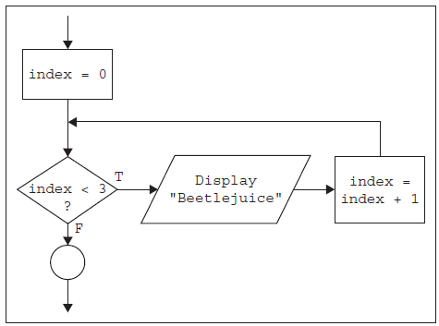
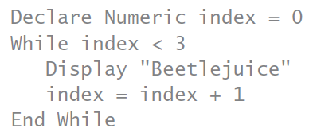
Controlling Loops (cont’d.)
Pretest loop
  Condition evaluated before executing statements
Statements in the loop body are indented
  End While lines up with While
  Example:
Figure 6-1 A flowchart segment for a While loop

Slide 10
Conditions, Counters, and
Sentinel Values
Loop variable usually incremented by one
  But can be any number
Decrementing
  Subtracting values from a loop variable
Determinate loop
  Loop executes a known number of times
Indeterminate loop
  Number of iterations unknown ahead of time
  Use a priming prompt
    Question to determine whether the loop repeats

Slide 11
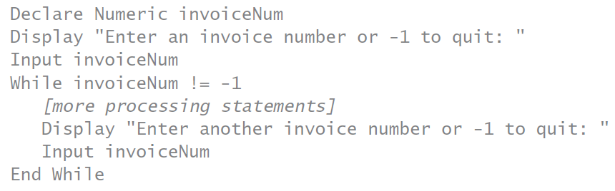
Conditions, Counters, and
Sentinel Values (cont’d.)
Sentinel value
  Special value that signals the end of input
  Can’t be used as a valid data value
  Example:

Slide 12
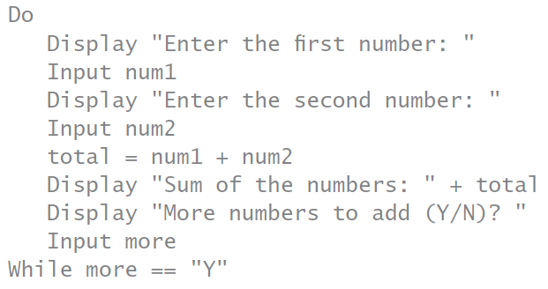
Conditions, Counters, and
Sentinel Values (cont’d.)
The Do While loop: a posttest loop
  Condition is evaluated after the loop body
  Loop body executes at least once
  Example:

Slide 13
Conditions, Counters, and
Sentinel Values (cont’d.)
Do While loop characteristics
  One entrance and one exit
  Condition guards the exit
Do While loop JavaScript syntax
  Closing brace lines up with do keyword
    Followed by while on the same line
    Then, condition and a semicolon

Slide 14
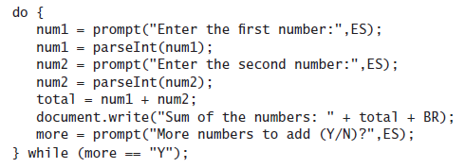
Conditions, Counters, and
Sentinel Values (cont’d.)
Do While loop example:

Slide 15
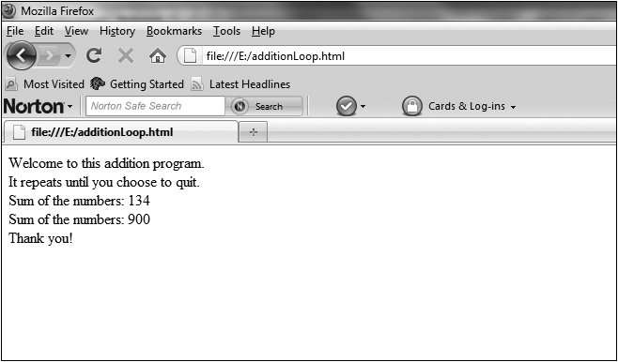
Conditions, Counters, and
Sentinel Values (cont’d.)
Complete Program 6-1 on pages 215-216
Figure 6-3 The additionLoop.html program in a Web browser

Slide 16
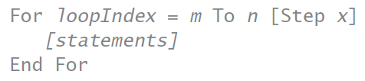
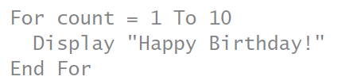
Conditions, Counters, and
Sentinel Values (cont’d.)
The For loop: combining three steps into one
  Factors controlling the loop are clearly apparent
  Useful for counter-controlled loops:
    When starting, ending, and increment amounts are known in advance
For loop: syntax

Slide 17
Conditions, Counters, and
Sentinel Values (cont’d.)
Increment operator
  Shortcut for incrementing a variable
  Two plus signs (++) appended to the variable name
  Adds 1 to the variable value
Decrement operator
  Two minus signs (--) appended to the variable name
    Subtracts 1 from the variable value

Slide 18

Conditions, Counters, and
Sentinel Values (cont’d.)
For loop in JavaScript
  For keyword and parenthesis containing:
    Loop variable, equals sign, starting value, semicolon
    Loop condition, semicolon
    Statement to alter the loop variable
  Example:

Slide 19
Conditions, Counters, and
Sentinel Values (cont’d.)
Complete Program 6-2 on pages 219-220

Slide 20
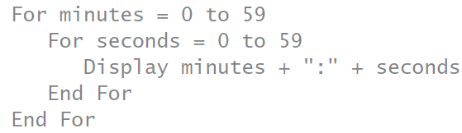
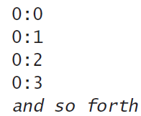

Nested Loops
Inner loop performs all its iterations:
  For every iteration of the outer loop
Example:
Output:

Slide 21
Accumulators
Loops that add to a total
  Input amounts are not known ahead of time
Example on next slide

Slide 22
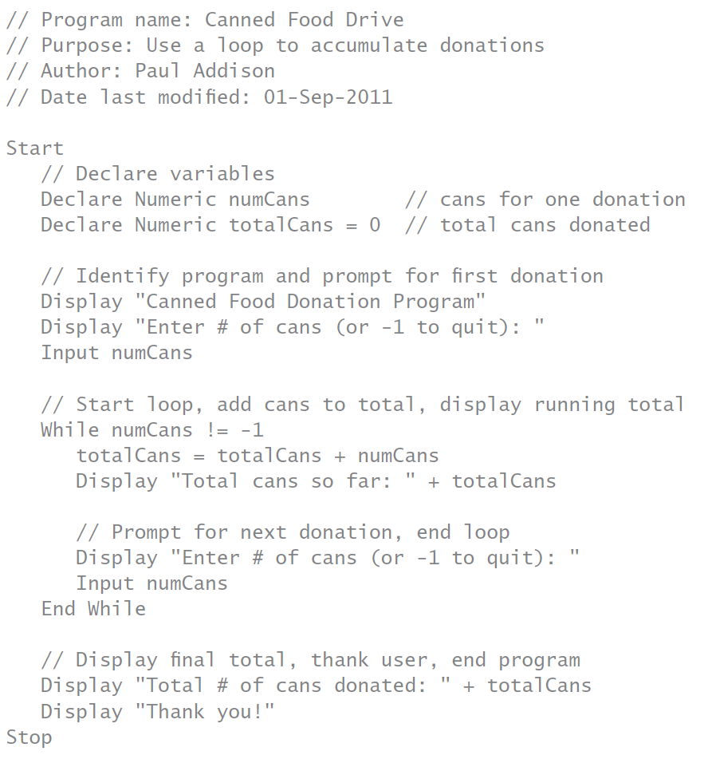

Slide 23
Using the Break and Continue Statements
Break statement
  Prevents the rest of the code from being performed
  Can be used in a While or Do While loop
  Should be used sparingly
Continue statement
  Breaks the normal flow of programming code
  Control goes immediately to beginning of loop
    Starts a new iteration

Slide 24
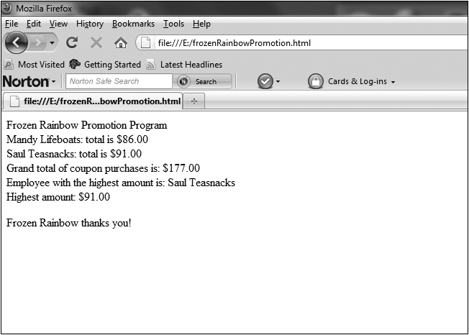
Using the Break and Continue Statements (cont’d.)
Complete Programmer’s Workshop on pages 225-228
Figure 6-5 The frozenRainbowPromotion.html program in a Web browser

Slide 25
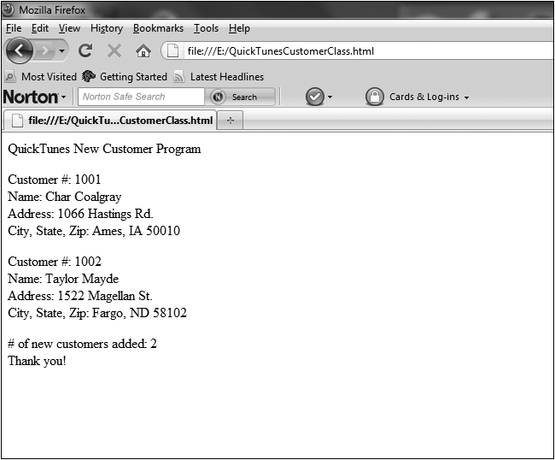
Using the Break and Continue Statements (cont’d.)
Complete Object Lesson on pages 229-234
Figure 6-7 The QuickTunesCustomerClass.html program in a Web browser

Slide 26
Summary
Repetition structure (loop) performs steps repeatedly:
  Based on evaluation of a condition
Loops have three control elements:
  Initialization, condition evaluation, and alteration of loop variable
While loop is a pretest loop
Determinate loop has known number of iterations

Slide 27
Summary (cont’d.)
Sentinel value signals end of valid data input
  Used with indeterminate loops
Do While loop is a posttest loop
For loop is a pretest loop
  Combines initialization, condition testing, and alteration on one line
Nested loops perform entire inner loop for each iteration of outer loop
Accumulator: running total

